Slide 1

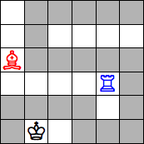
Chess Snake Puzzles – 2022 IA Project
Carlos Gomes – UP201906622
Domingos Santos – UP201906680
Filipe Pinto – UP201907747

Slide 2
Specifications
The main goal for this project is to, based on Artificial Inteligence skills, and search algorithms, draw a snake that goes from the lower left square to the upper right square;
Each chess piece should attack the sane number of segments of the snake;
This project should allow different level games and multiplayer options;

Slide 3
Related Work
https://erich-friedman.github.io/puzzle/snake/
https://moodle.up.pt/ (course files)
https://pedros.works/chess-snake

Slide 4
Search Problem Formulation

Slide 5
Implementation

